Slide 1
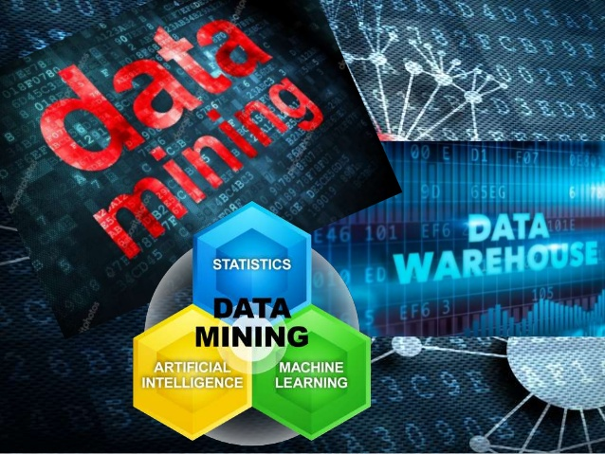
Subject: Elective – 1 Data Mining and Warehousing
Class: BE (A & B)
A.Y 2021-22 SEM I
Faculty – Prof. Trupti Phutane
DEPARTMENT OF COMPUTER ENGINEERING
DYPTC, Ambi.

Slide 2
Course objectives & course outcomes
COURSE OBJECTIVES:
To understand the fundamentals of Data Mining
To identify the appropriateness and need of mining the data
To learn the preprocessing, mining and post processing of the data
To understand various methods, techniques and algorithms in data mining
COURSE OUTCOMES:
Apply basic, intermediate and advanced techniques to mine the data
Analyze the output generated by the process of data mining
Explore the hidden patterns in the data
Optimize the mining process by choosing best data mining technique

Slide 3
UNIT-1 INTRODUCTION
Data Mining, Data Mining Task Primitives,
Data: Data, Information and Knowledge; Attribute Types: Nominal, Binary, Ordinal and Numeric attributes,
Discrete versus Continuous Attributes;
Introduction to Data Preprocessing,
Data Cleaning: Missing values, Noisy data;
Data integration: Correlation analysis; transformation: Min-max normalization, z-score normalization and decimal scaling;
Data reduction: Data Cube Aggregation, Attribute Subset Selection,Sampling; and Data Discretization: Binning, Histogram Analysis

Slide 4
Data Vs Information Vs Knowledge
What is Data Mining?
Confluence of Multiple disciplines
Why Data Mining?
Application of Data Mining
KDD Process (Knowledge discovery in Databases)
Data Mining Task Primitives
Steps of Data Mining
Data Mining Techniques
Attributes Types

Slide 5
DATa vs information vs knowledge
Data: - a "given" or a fact; number; picture - Data has no meaning when it has not been interpreted. - raw materials in production of information
Information: -Information is processed data (i.e. Data after manipulation). - Information is the meaning that has been formed with the help of data - Information cannot be generated without the help of data.
Knowledge: - Our personal map/model of the World - Acquired through experience or learning - Awareness and understanding of someone or something
Conclusion:
➢ Data is all data that can be processed, it can be structured or unstructured.
➢ Information is processed data, like a report.
➢ Knowledge is understanding of the information (learned information).

Slide 6
What is data Mining?
Definition: Extraction of interesting (non-trivial, implicit, previously unknown and potentially useful) patterns or knowledge from huge amount of data.

Slide 7
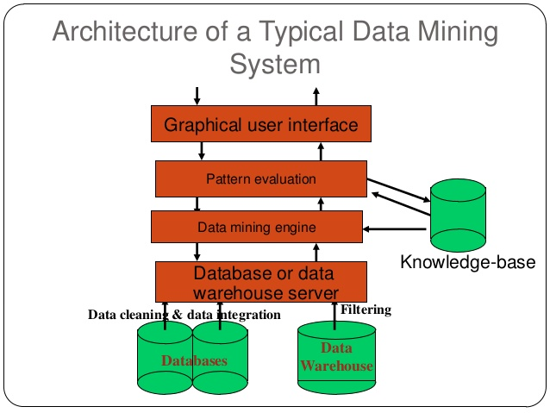
Architecture of data mining system

Slide 8
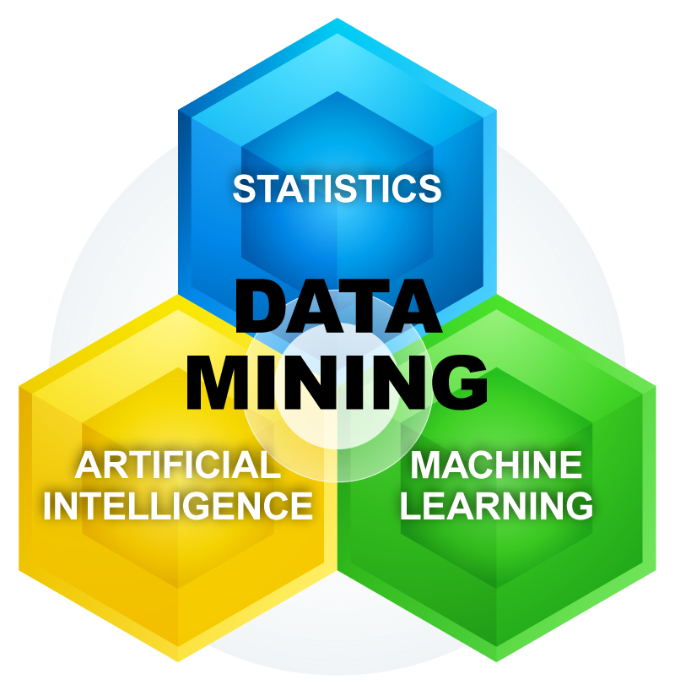
Confluence of multiple disciplines(Application Domains)

Slide 9
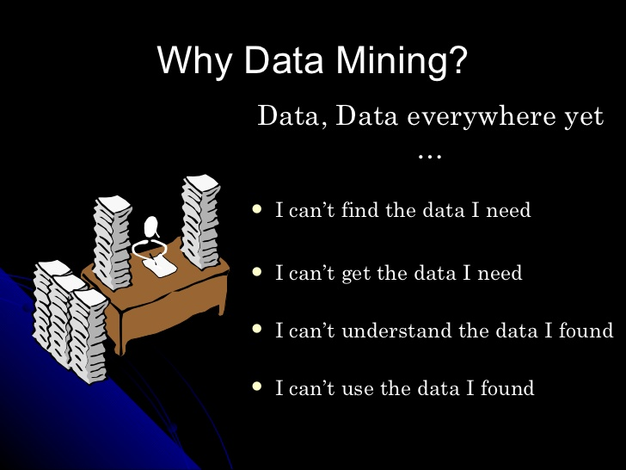

Slide 10
Why data mining?
Data Explosion Problem
Advance data collection tool and database technology lead to tremendous amounts of data stored in the database.
We are drowning in data but starving for knowledge!
Solutions: Data Warehousing and Data Mining.
Data warehousing and online analytical preprocessing
Extraction of interesting knowledge using data mining

Slide 11
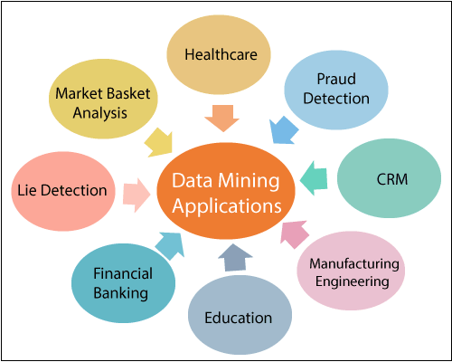
Application of data mining

Slide 12
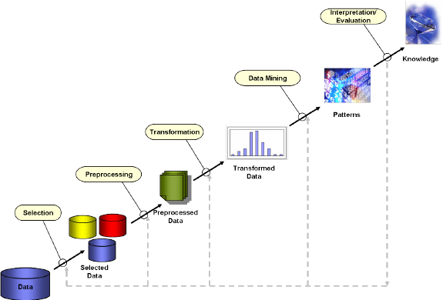
KDD Process (Knowledge discovery in Databases)

Slide 13
KDD (Knowledge Discovery in Databases) is a field of computer science, which includes the tools and theories to help humans in extracting useful and previously unknown information (i.e. knowledge) from large collections of digitized data.
KDD is the overall process of extracting knowledge from data

Slide 14
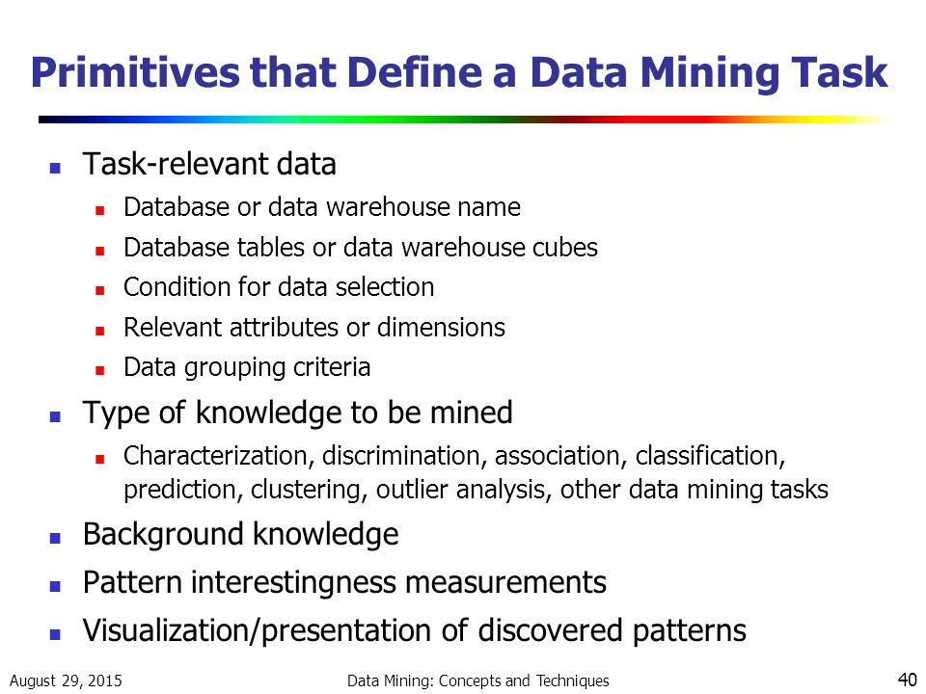
Data mining task primitives

Slide 15
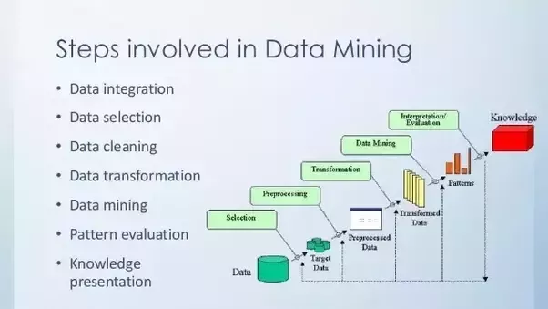
Steps of data mining

Slide 16
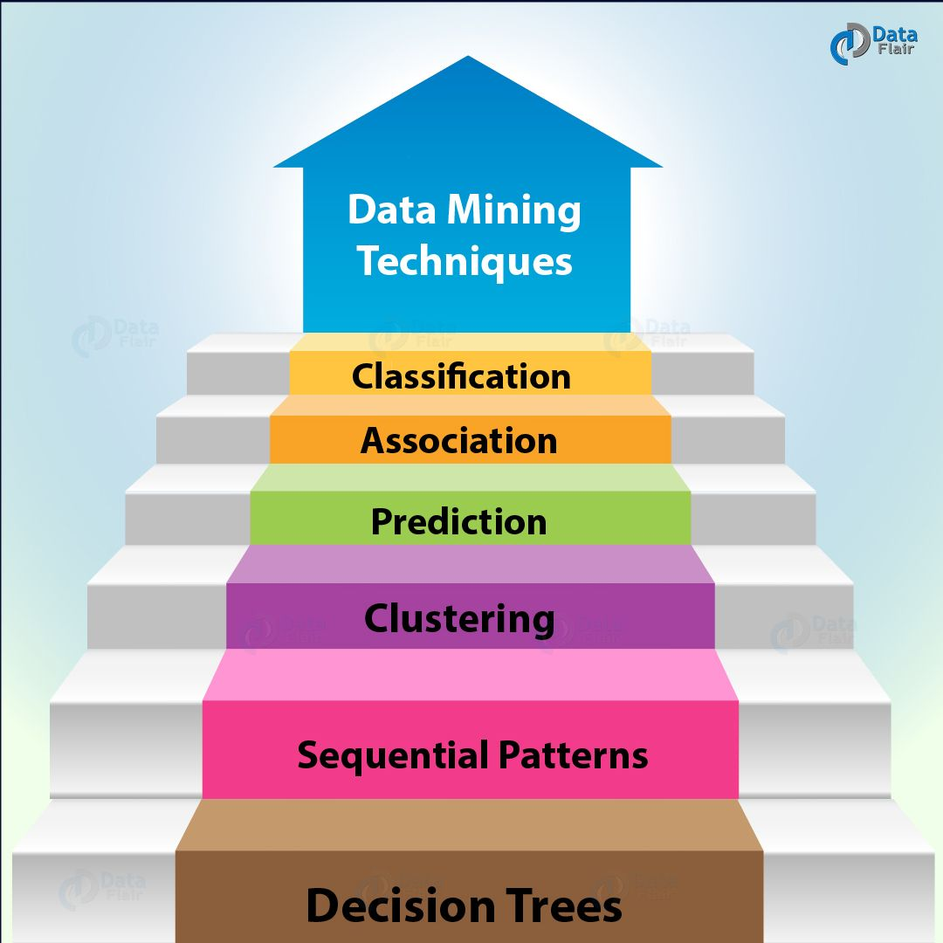
Data mining techniques

Slide 17
Attributes types
Nominal Attributes
Binary Attributes
Ordinal Attributes
Numeric Attributes
Discrete versus Continues Attributes

Slide 18
Data Objects and Attributes
Nominal Attributes
Binary Attributes
Ordinal Attributes
Numeric Attributes
Discrete versus Continues Attributes
Introduction to Data Preprocessing
Data Cleaning: Missing values, Noisy data

Slide 19
Data objects & attributes
Data Object – Logical Cluster of all tables in the data set containing data related to same entity.
E.g- Retail store – Employee, customer, items, sales are the objects.
Every data object described by its properties called as attributes and stored in database in the form of row or a tuple.
Attributes – It is a property or characteristics of a data object.
E.g – chalk, duster, board, students,teacher are the characteristics of the Data Object Classroom.

Slide 20
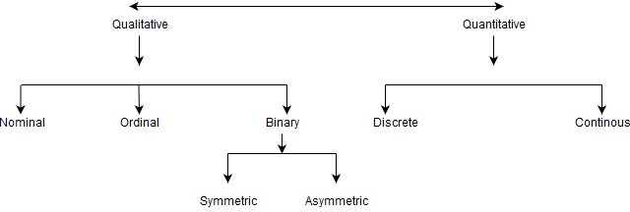

Slide 21
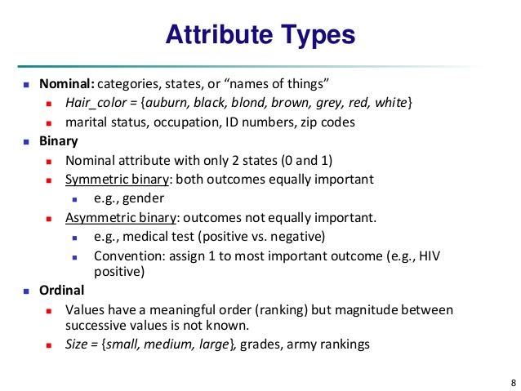

Slide 22
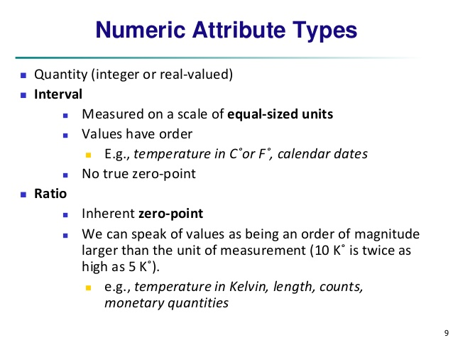

Slide 23
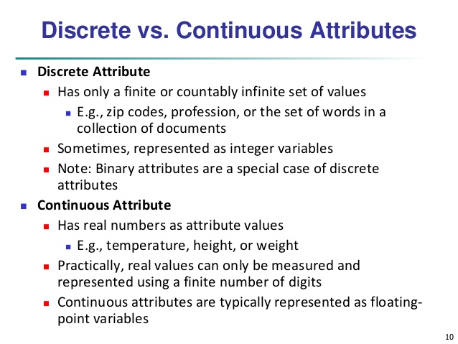

Slide 24
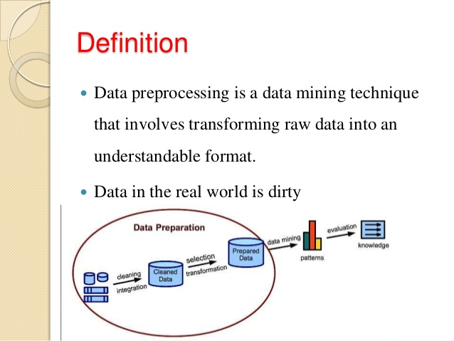
Introduction to data preprocessing

Slide 25
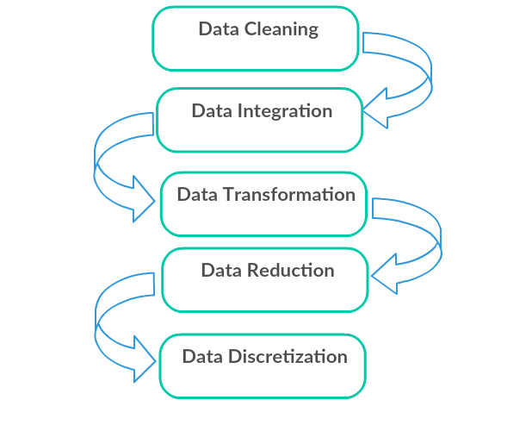
Different forms of data pre-processing

Slide 26
Data cleaning
Data cleaning is also known as scrubbing.
This process detects and removes the errors and improves the quality of data.
Data quality problems arise due to misspellings during data entry ,missing values or any invalid data.
Reasons for “Dirty” Data
Dummy values
Absence of Data
Multipurpose fields
Contradicting data
Reused primary keys

Slide 27
Steps in data cleansing
Parsing
Correcting
Standardizing
Matching
Consolidating
Data Cleansing must with many types of possible errors
Data staging

Slide 28
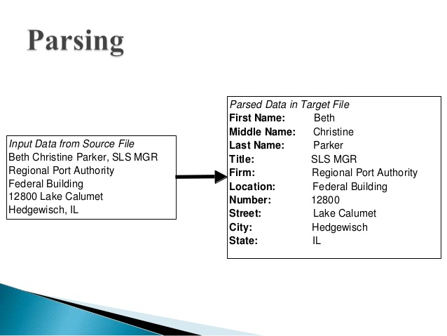
Parsing : It is a process in which individual data elements are located and identified in the source systems. E.g – Parsing of name into First name, Middle name and Last Name or Address into Street name, city, state and country.

Slide 29
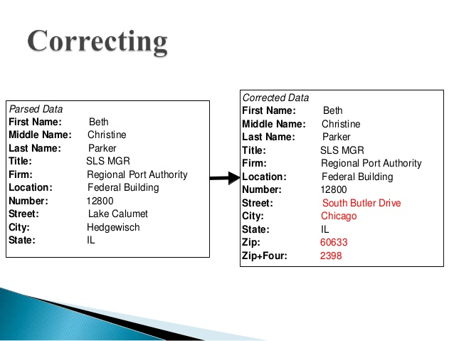
2. Correcting : Individual data are corrected using data algorithm and secondary data sources.

Slide 30
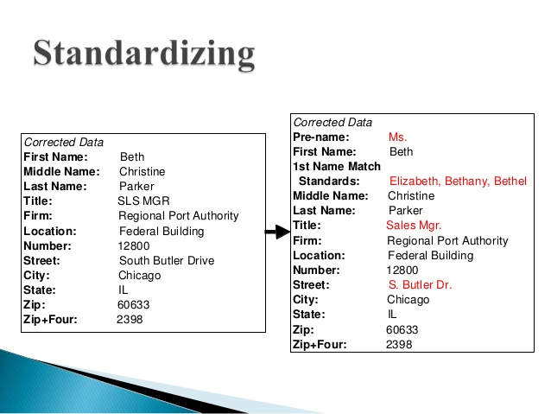
3. Standardizing : In this, conversion routines are used to transform data into a consistent format using standard and custom business rules.

Slide 31
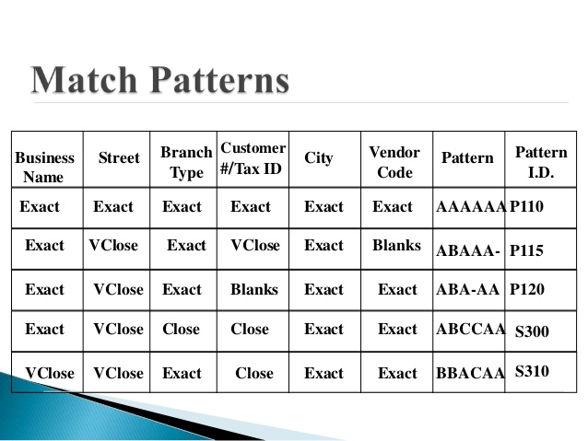
4. Matching : It involves eliminating duplications by searching and matching records with parsed, corrected and standardised data using some standard business rules.

Slide 32
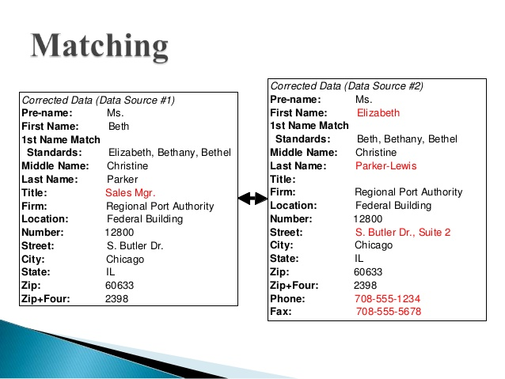

Slide 33
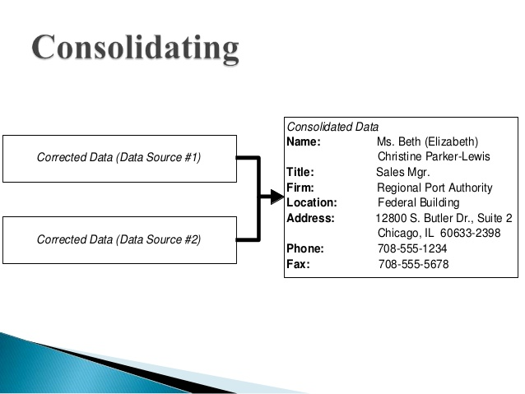
5. Consolidating : It involves merging the records into one representation by analysing and identifying relationships between matched records.

Slide 34
6. Data Cleansing must deal with many types of possible errors : Data can have many errors like missing data, or incorrect data at one source.
7. Data Staging : It is an interim step between data extraction and remaining steps. For data staging, operational data store may be used.

Slide 35
Missing values
Involves searching for empty fields where values should occur.
Data is corrected in data pre-processing process by filling out the missing values, smoothening out the noise and correcting inconsistencies.
There are different ways to handle missing values in databases:
Ignore the data row
Fill the missing values manually
Use a global constant to fill in for missing values
Use attribute mean
Use attribute mean for all samples belonging to the same class.
Use a data mining algorithm to predict the most probable value

Slide 36
Ignore the data row – E.g (Students Performance in college) – Age, score, address, Performance in college to “Low”, ”Medium” & “High”. In this, if performance column is missing then remaining data is of no use and hence they can be ignored.
Fill the missing values manually – This is not feasible for large data set and also time consuming.
Use a global constant to fill in for missing values – E.g (Student DB) If the address attribute is missing for some students then it does not makes sense in filling up these values and so global constant can be used as “unknown”, “N/A”.
Use attribute mean – Here mean or median of its discrete values may be used as replacement. E.g In family income, missing values may be replaced by its average income.
Use attribute mean for all samples belonging to the same class – Replacing the missing values by its mean or median considering class wise data makes it more relevant. Eg – Car Pricing database with classes “Luxury” and “Low budget”. Here, replacing missing cost of a luxury car with average cost of all luxury car makes the data more accurate.
Use of a data-mining algorithm to predict the most probable value – Missing values may be filled by using techniques like regression, decision trees, clustering algorithms.

Slide 37
Noisy data
A random error or variance in a measure variable is known as Noise.
Noise in the data may be occurred due to:
1. Fault in data collection instruments
2. Error introduced at data entry by human or computer
3. Data transmission errors.
Different types of Noise in data:
1. Unknown encoding : Gender :E
2. Out of range values : Temperature : 1004,Age : 125
3. Inconsistent enteries: DoB : 10-Feb-2003; Age : 30
4. Inconsistent formats: DoB : 11- Feb-1984; DoJ : 2/11/2007

Slide 38
How to handle noisy data
Three ways to handle Noisy Data:
1) Binning –
Equal –width (distance) partitioning
Equal – depth (frequency) partitioning or Equal height binning
2) Clustering
3) Regression

Slide 39
Binning
Sorted data is placed into bins or buckets
Smoothening by Means
Smoothening by Medians
Smoothening by Boundaries
Equal –width (Distance) Partitioning – Divides the range into N intervals of equal size: Uniform Grid.
Bin width = (max value – min value) / N
E.g: Consider a set of values in range from 0 to 100
The data could be placed into 5 bins as follows:
Width = (100-0)/5 = 20
Bins formed are:
[0-20],[20-40],[40-60],[60-80],[80-100]

Slide 40
2. Equal-depth (frequency) partitioning or Equal-height binning –
Entire range is divided into N intervals, each containing same number of samples. This results in good data scaling.
E.g- Let us consider sorted data e.g Price in INR
4,8,9,15,21,21,24,25,26,28,29,34
Partition into (equal-depth) bins: (N=3)
Bin 1: 4,8,9,15
Bin 2 : 21,21,24,25
Bin 3 : 26,28,29,34
Smoothening by bin means
Replace each value of bin with its mean value
Bin 1 : 9,9,9,9
Bin 2 : 23,23,23,23
Bin 3 : 29,29,29,29

Slide 41
Smoothening by bin Medians
Replace each value by bin median
Bin 1 : 8.5,8.5,8.5,8.5
Bin 2 : 22.5,22.5,22.5,22.5
Bin 3 : 28.5,28.5,28.5,28.5
Smoothening by Bin Boundaries – Each value is replaced with its nearest value either minimum or maximum
Bin 1 : 4,4,4,15
Bin 2 : 21,21,25,25
Bin 3 : 26,26,26,34

Slide 42
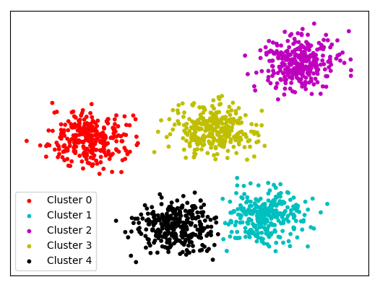
clustering
Outliers can be detected by using clustering techniques, where related values are organized into groups or clusters
Partition data set into clusters i.e replace all values of the cluster by that one value representing the cluster.

Slide 43
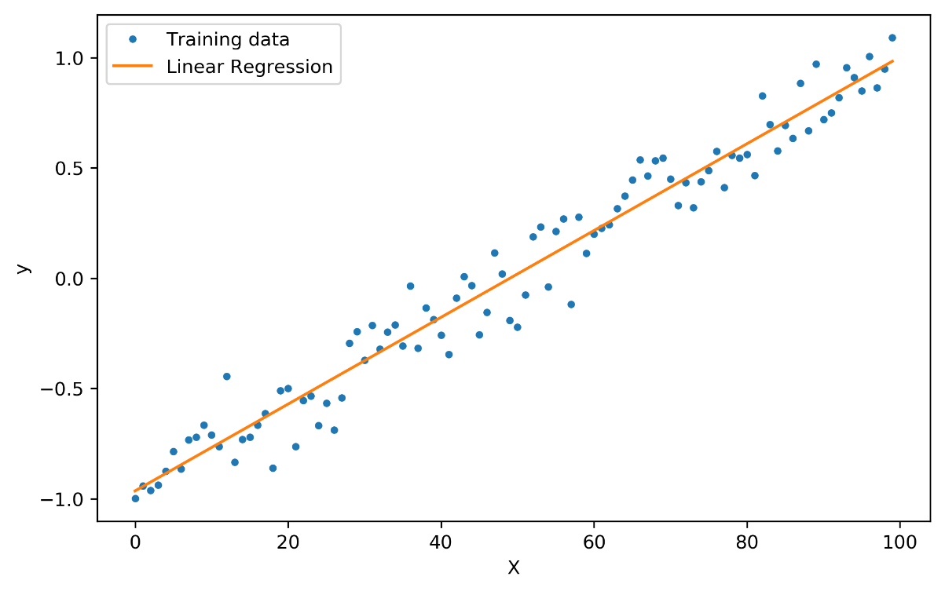
regression
Regression is a statistical measure used to determine strength of relationship between one dependent variable denoted by Y.
Use regression analysis on values of attributes to fill missing values.
Two types of regression:
Linear Regression
Multiple Regression

Slide 44
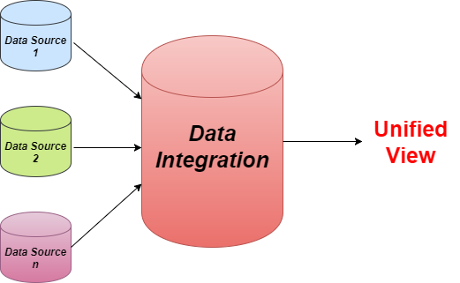
Data integration
Data Integration is a data preprocessing technique that involves combining data from multiple heterogeneous data sources into a coherent data store and provide a unified view of the data. These sources may include multiple data cubes, databases or flat files.

Slide 45
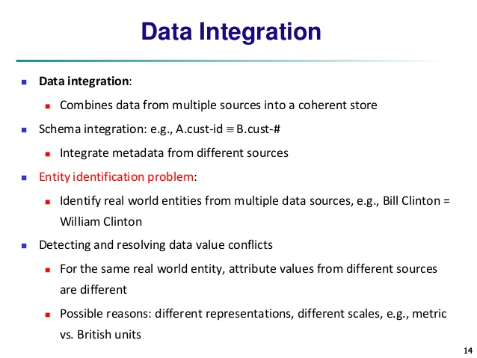
Issues in data integration

Slide 46
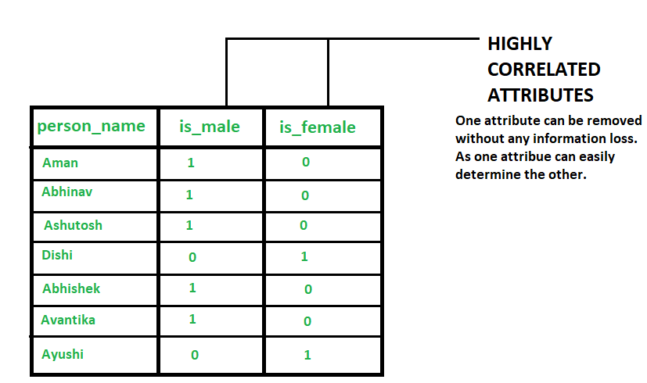
Redundancy and correlation analysis
Data redundancy occurs when data from multiple sources is considered for integration.
An attribute (column or feature of data set) is called redundant if it can be derived from any other attribute or set of attributes.
E.g if we have data set having 3 attributes-person_name,is_male,is_female.
Is_male is 1 if corresponding person is male else it is 0.
Is_female is 1 if corresponding person is female else it is 0.
It implies that 2 attributes are highly correlated and one attribute can determine the other.

Slide 47
Hence, one of these become redundant. So one of these two attributes can be dropped without any information loss.
To reduce or avoid redundancies Data Integration is important.
X^2 (Chi-Square) can be carried out on nominal data to test how strongly the two attributes are related.

Slide 48
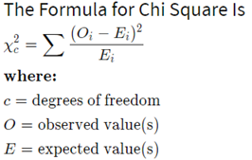
The X^2 (Chi-Square)
The Chi-square is used to test the probability of independence of a distribution of data but does not gives you any details about the relationships between them
For nominal data,a correlation relationship between two attributes p & q can be discovered by an X^2 (Chi-Square)
It does not work for numeric data.
Examples of nominal variables include Gender (the possible values are Male or Female)etc.

Slide 49
Data transformation
Operational databases keep changing with the requirements , so a data warehouse integrating data from these multiple sources facing the problem of inconsistency.
E.g Manager name may be MGM_NAME in one database ,MNAME in the other.
To deal with these inconsistent data, “Transformation” process is used.
Data Transformation can have following activities:
Smoothing: It involves removal of noise from the data.
Aggregation: It involves summarisation and data cube construction
Generalization: Data is replaced by higher level concepts using concepts hierarchy.
Normalization: Attribute scaling is performed for a specified range.

Slide 50
Data transformation by normalization
It is the process of making an entire set of values have a particular property.
Methods for Normalization:
Min-Max Normalization
Z-score
Decimal Scaling

Slide 51
Min-max normalization
Min Max normalization results in a linear alteration of the original data. The values are within a given range.
Formula is as below:
V’=(V-minA)/(maxA-minA) * (new_maxA-new_minA) + new_minA

Slide 52
Example: Consider the following group of data : 200,300,400,600,1000
Use the min-max normalization to transform value 600 onto the range [0.0,1.0]
Use the decimal scaling to transfer the value 600.
Solution:
Min : Min value of given data =200
Max : Max value of givrn data =1000
V= 600 = ((V-min) / (max-min) * (1-0)+0
= (600-200)/(1000-200) * (1-0)+0
= (400/800) * 1
= 0.5
ii) Decimal Scaling for 600
10^K is 10”3=1000
600/1000 = 0.6

Slide 53
Example : Suppose that the minimum and maximum value for the atttibute income are $12,000 and $98,000 respectively. Normalize income value $73,600 to range [0.0,1.0] using min-max Normalization method.
Solution: Min = 12000
Max = 98000
V = 73600
V’ = (v-min A)/(maxA-mina)*(new_maxA-new _mina)+new_mina
=(73600-12000)/(98000 – 12000) * (1-0) +0
= (61600/86000)*1
= 0.7

Slide 54
Z-score
E.g –If Data given {10,20,30},then
Mean = 20
Std_Dev = 10
So V’= (-1,0,1)
In Z-score normalization,data is normalized based on the men and standard deviation.Z-score is also known as Zero mean normalization.
Formula is : V’= (V- mean A)/std_devA
Where, Mean A = sum of all attribute value of A
Std_Dev A = Standard deviation of all values of A

Slide 55
Decimal Scaling
Example: For the range between -991 and 99,
10^k is 1000 (k=3 as we have maximum 3 digit number in the range)
V’(-991) = -0.991 and ‘’V’(99) = 0.099
Based on the maximum value of the attributes the decimal point is moved.This process is known as “Decimal Scale Normalization”
Formula:
V’(i) = v(i)/10^k for the smallest k such that max(|v’(i)|<1

Slide 56
Data reduction
Why data reduction?
➢ A database/data warehouse may store terabytes of data. Complex data analysis/mining may take a very long time to run on the complete data set.
Data reduction: Obtain a reduced representation of the data set that is much smaller in volume but yet produce the same (or almost the same) analytical results.
Data reduction strategies:
➔ Data cube aggregation
➔ Dimensionality reduction
➔ Data Compression
➔ Numerosity reduction
➔ Discretization and concept hierarchy generation

Slide 57
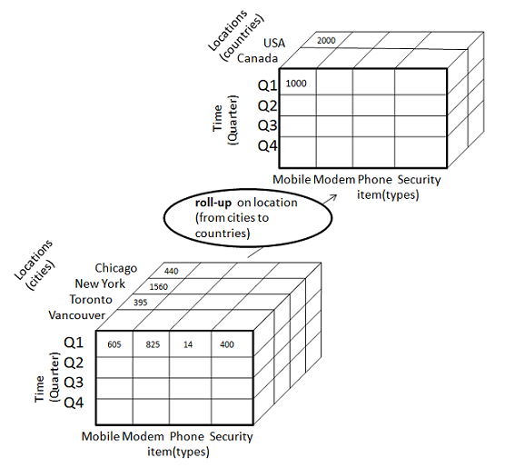
Data cube aggregation
It reduces the data to the concept level needed in the analysis and uses the smallest level necessary to solve the problem.

Slide 58
Attribute subset selection
It refers to a process in which minimum set of attributes are selected in such a way that their distribution represents the same as the original data set distribution considering all the attributes.
Different attribute subset selection techniques:
Forward selection
Stepwise backward elimination
Combination of forward selection and backward elimination
Decision Tree Induction

Slide 59
Forward Selection:
Start with empty set of attributes.
Determine the best of the original attributes and add it to the set.
At each step, it finds the best original attributes and add it to the set.
Stepwise backward Selection:
Starts with full set of attributes.
At each step.It removes the worst attribute remaining the set.
Combination of Forwad Selection and Backward Selection:
It combines and selects the best attribute and removes the worst among the remaining attributes.
Decision Tree Induction:
Construct a flow chart like structure.
Decision tree is a tree in which:
Each node tests an attribute
Each branch corresponds to attribute value
Each leaf node assigns a classification.

Slide 60
sampling
Sampling is the process of selecting units from a population of interest so that by studying the sample we may fairly generalize our results back to the population from which they were chosen.
It is important in data mining as processing the entire data set is expensive and time consuming.
Types of Sampling:
Simple random sampling
Sampling without replacement
Sampling with replacement
Stratified Sampling

Slide 61
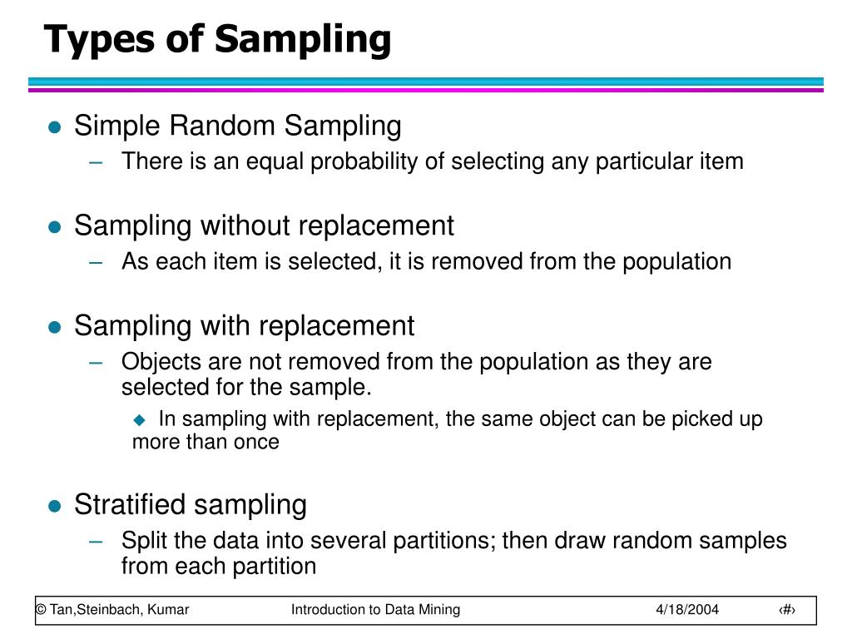

Slide 62
Data discretization
Discretization techniques can be used to reduce the number of values for a given continuous attribute, by dividing the attribute into a range of intervals.
Interval labels can then be used to replace actual data values.
Many discretization techniques can be applied recursively in order to provide a hierarchical partitioning of the attribute values known as concept hierarchy.

Slide 63
Discretization by binning
This is Data Smoothing Technique.
It has two Approches:
Equal-width (distance) partitioning
Equal-depth (frequency )partitioning or Equal – height binning.
NOTE: Already seen in (Noisy Data)

Slide 64
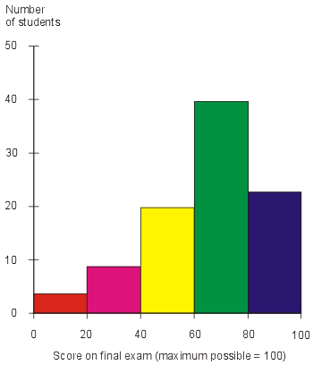
Discretization by Histogram analysis
A histogram is a graphical representation of the distribution of numerical data.
Divide data into buckets and store average (sum) for each bucket.
Types of Histogram: -
Equal-width
Equal-depth (frequency) partitioning
V-optimal
MaxDiff

Slide 65
THANK YOU

